Slide 1

IIIT Lucknow Capstone Project
Fire Detection Using Surveillance Camera on Roads

Slide 2
Small Introduction about our Project
There are various incidents when some places catches fire and before someone sees it, it becomes too late to extinguish it.
Sometime human eyes cannot catch fire because it is too low to be seen but it can be easily recognized by computers.
Our project is purely based on same thing.

Slide 3
Timeline for the Project
Submitted by : Akash Papnai, Vipul chandra
Submitted to : Prof. Deepak singh

Slide 4
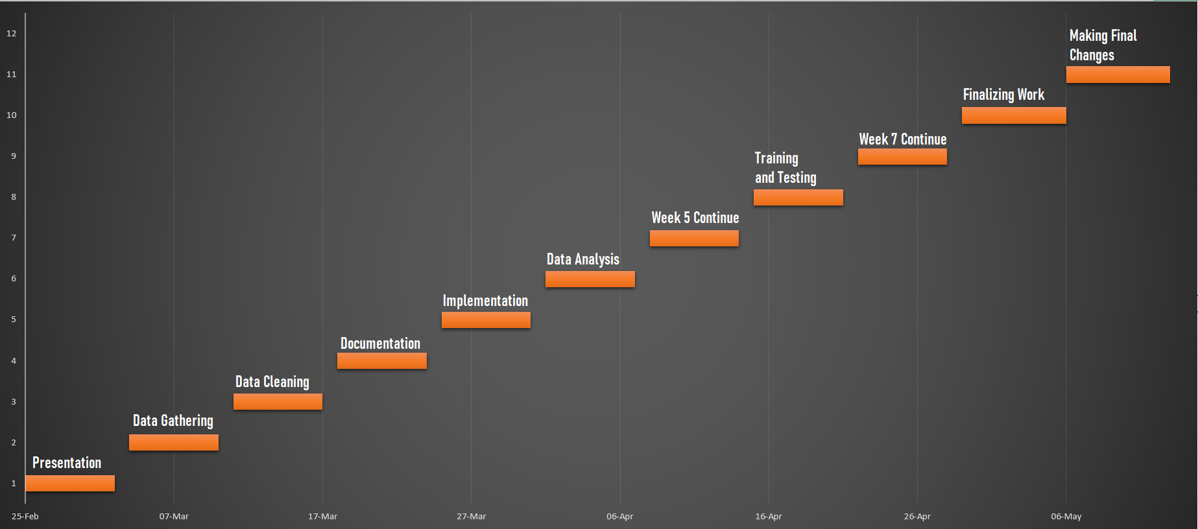
Timeline Overview

Slide 5
Week 1 (25 February)
Data Gathering
This week all the focus will be on collecting all the data required for this project.

Slide 6
Week 2 (4 March)
Cleaning of Data
This will we will be doing all the data cleaning required for the project.

Slide 7
Week 3 (11 March)
Documentation
After studying all the data and then cleaning it, this week will all be focused on creating the documentation of the project which will be basically about the project, how we came across it, etc.

Slide 8
Week 4 (18 March)
Implementation initialization
This will be week of start of implementation of the project. This will be one of the busiest week of all the 11 weeks.

Slide 9
Week 5 (25 March)
Data Analysis
This week, we will focus on analyzing the data. This week we will focus on how data can be represented using graph.

Slide 10
Week 6 (1 April)
Continuing Week 5
As there will be a lot of work on Week 5, so further work of Week 5 will be done on Week 6.

Slide 11
Week 7 (8 April)
Training and Testing the Dataset
This week will be focused on training and testing of the dataset using ML Algorithm. There are lot of libraries which will help us to do so but we’ll be using Tensorflow here.

Slide 12
Week 8 (15 April)
Continuing Week 7
As there will be a lot of work on Week 7, so further work of Week 7 will be done on Week 8.

Slide 13
Week 9 (22 April)
Finalizing work
Finalizing our work and getting the suggestion from the faculty for any further changes that can be done to improve project.

Slide 14
Week 10 (29 April)
Making final changes
If there will be any suggestion from the professor side regarding changes, that we’ll try to implement in the project.

Slide 15
Week 11 (6 May)
Research Paper
If the changes done by us are implemented successfully and such thing wasn’t done on this planet earlier, then we’ll send our project to Research paper.

Slide 16
THANK YOU

